Slide 1
Perth Observatory
Present

Slide 2
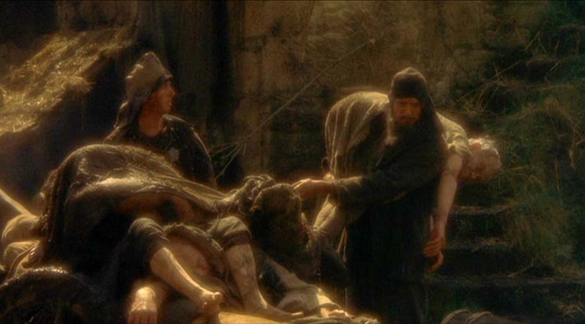
We're Not Dead Yet

Slide 3
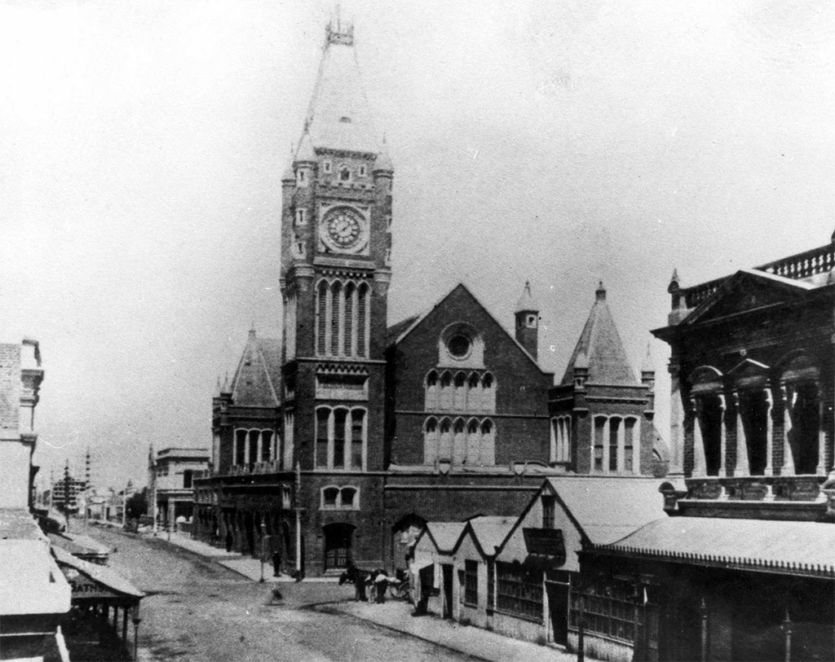
A Young Colony On The Rise
Notes:
The rapid growth of the Perth’s population in the 1890’s due to the gold rush

Slide 4
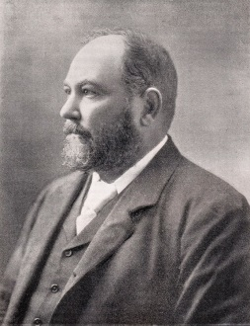
Sir John Forrest
Notes:
Sir John Forrest, Western Australia’s first premier wanted new public facilities. The aim for the Observatory
Accurate time
Weather reports
Record seismic activity
Observations of the southern sky

Slide 5
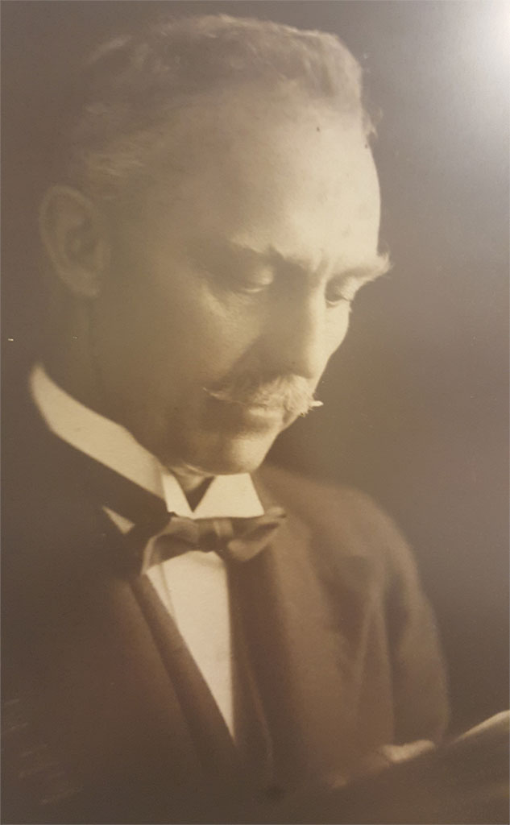
William Ernest Cooke Era
1896 to 1912

Slide 6
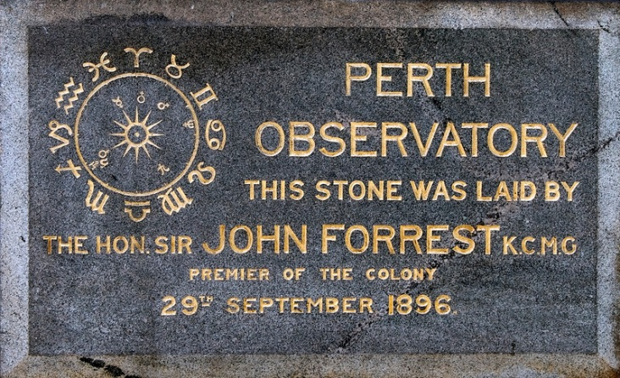
The Foundation Stone
Notes:
Cooke had drawn up a design for the foundation stone

Slide 7
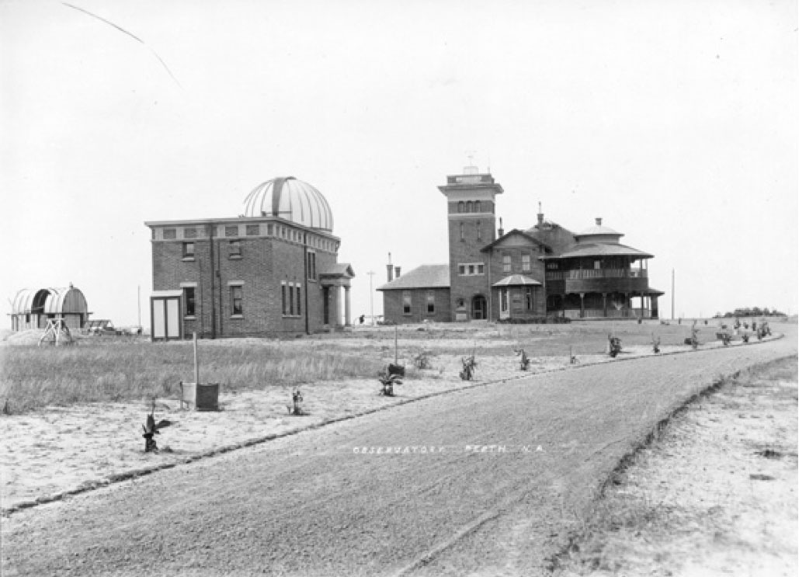
The Observatory

Slide 8
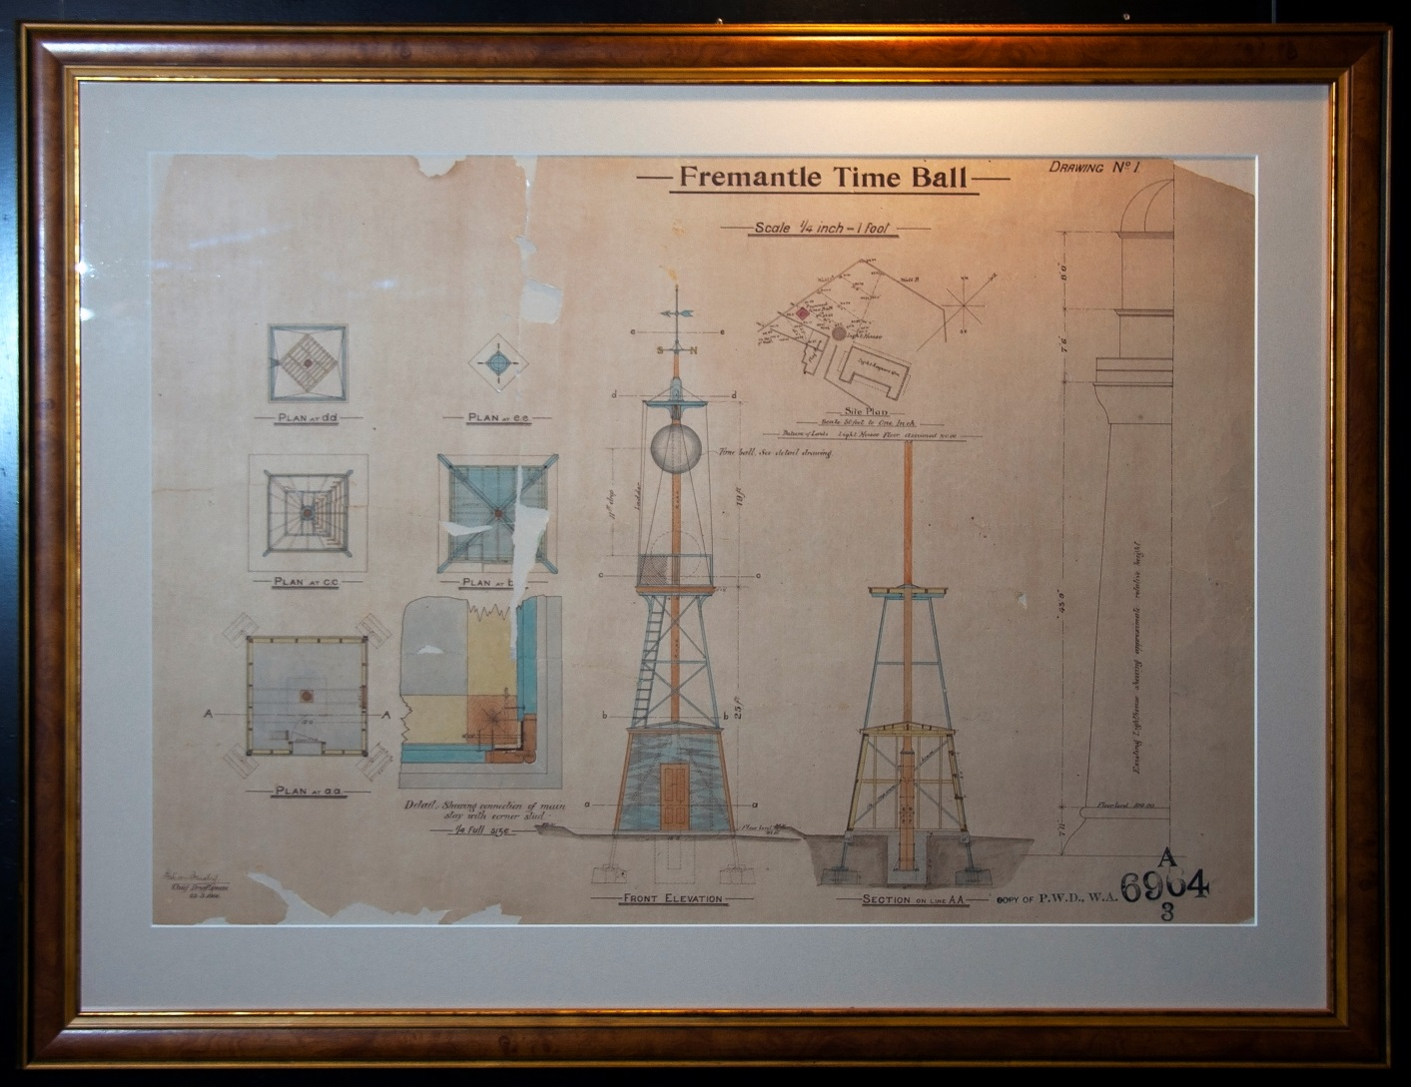
Plans For The Fremantle Time Ball
Notes:
Developed time service that provide regular time signals to shipping at Fremantle,
the State railways, and the telegraph system
controlled public clocks in Perth and 21 towns

Slide 9
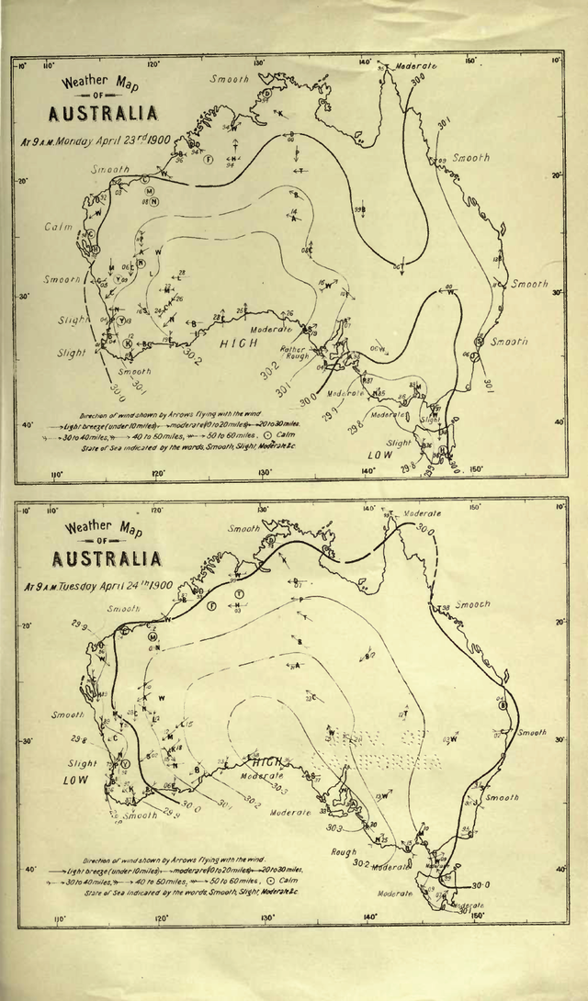
Cooke’s Weather Map Of Australia
Notes:
Weather forecasts were also displayed in prominent places in the city and published in the press.
Weather recordings were collated and published as annual Meteorological Reports
The Observatory also provided tide tables for the north-west ports, and astronomical information, including tables of sunrise and sunset
Cooke also confirmed that the weather was coming from the Indian ocean and then reaching SA, VIC, NSW and then NZ
Until 1908 when it was given to the Bureau of Meteorology

Slide 10
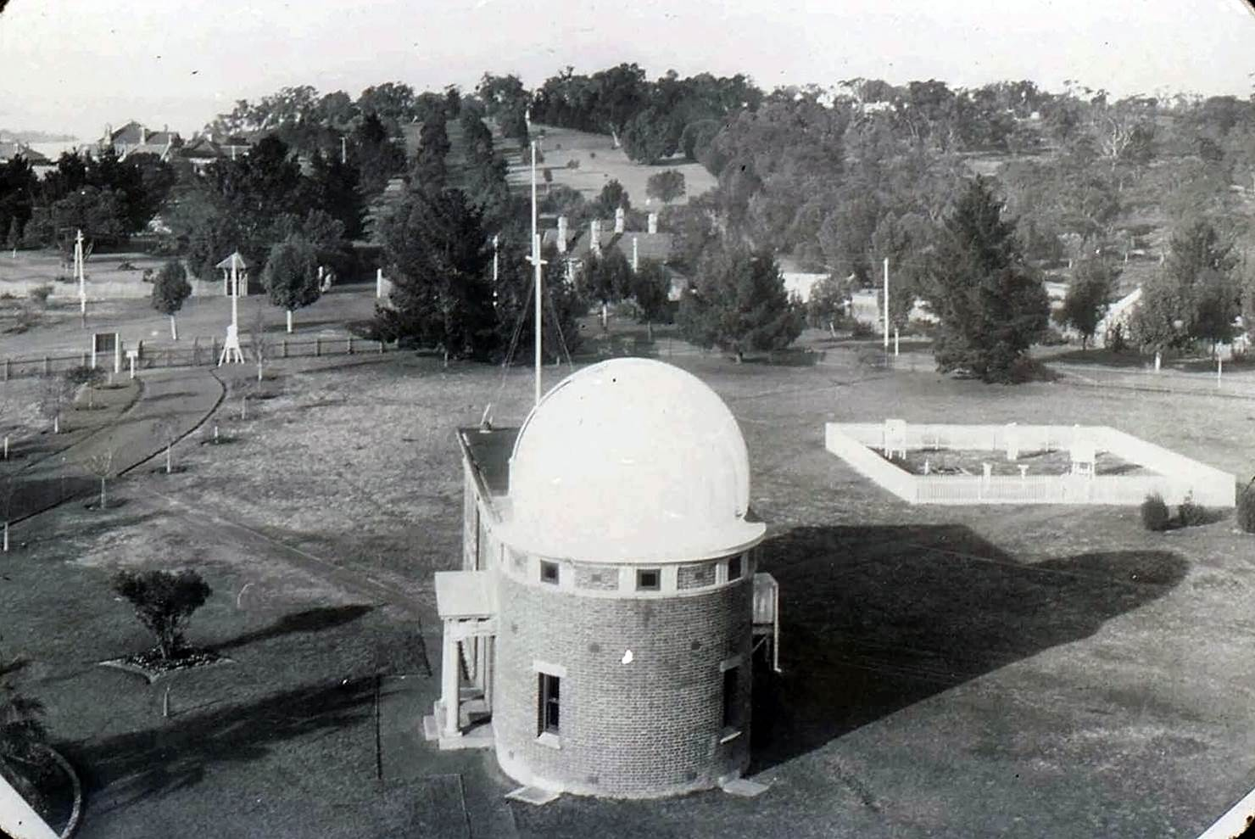
Looking On To King’s Park
Notes:
Invited to contribute to the Carte Du Ciel Program (1901 to 1919)
A Catalogue of 420 Standard Stars was published by the Perth Observatory
Established the exact latitude and longitude for the Observatory in 1899

Slide 11
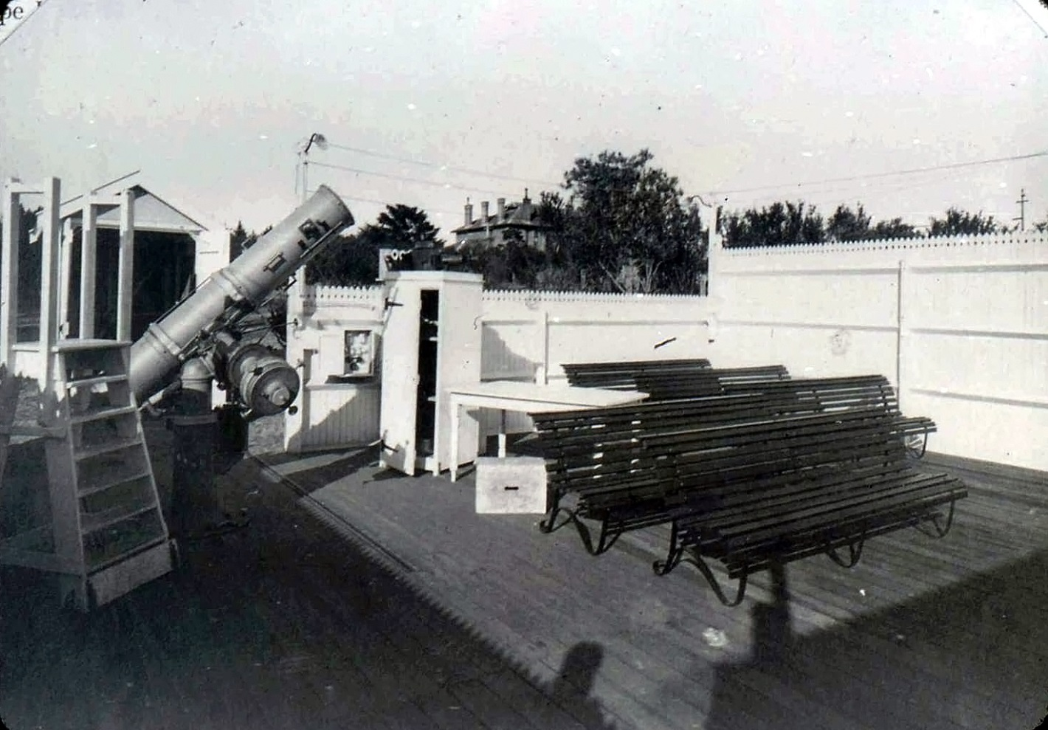
Public Viewing Area
Notes:
Public lectures in astronomy were provided in the evening.
The Calver for bought in 1910 to be the first public viewing telescope to give more time to research for the Astrograph and to study Halley’s Comet
In 1912, Cooke resigned to take up an appointment with the Sydney Observatory

Slide 12
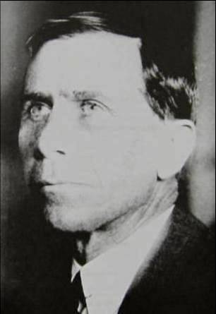
Harold Curlewis Era
1912 to 1940
Notes:
His position was not officially filled until 1920, when Harold Curlewis was promoted from Acting Government Astronomer to Government Astronomer.
Due to the state government’s lack of support for the Observatory.

Slide 13
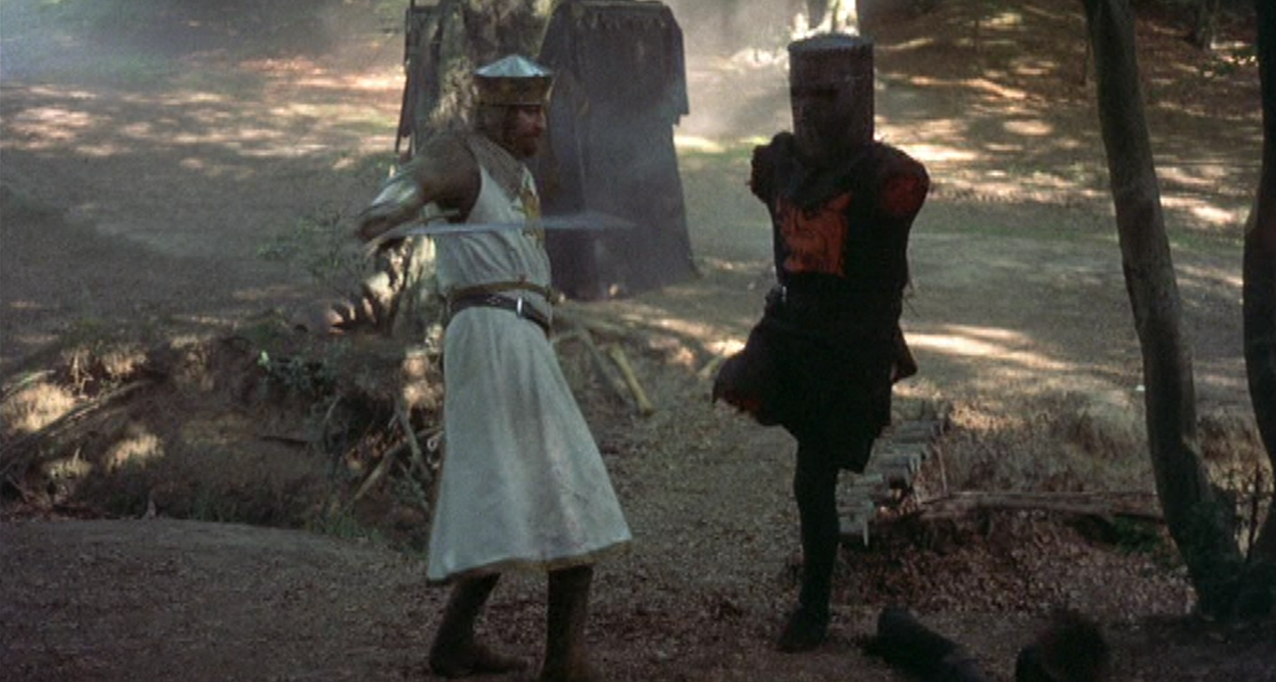
Bah! Just a flesh wound
Notes:
The state government had even applied to the commonwealth government to take the running of the Observatory over in 1902

Slide 14
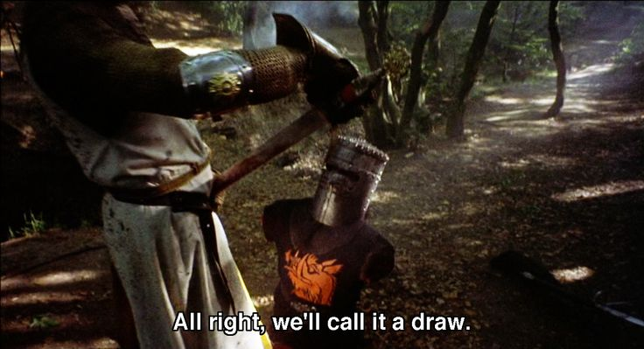
We Stave Off Death

Slide 15
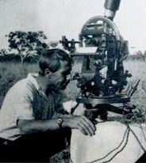
Curlewis using a 12" theodolite
Notes:
In 1920 and 1921 Curlewis was involved with the Government Astronomer of South Australia, to determine the fix positions for marking of the WA/SA border at Deakin
In 1921 used wireless radio time signals & other methods for position of the NT/WA border

Slide 16
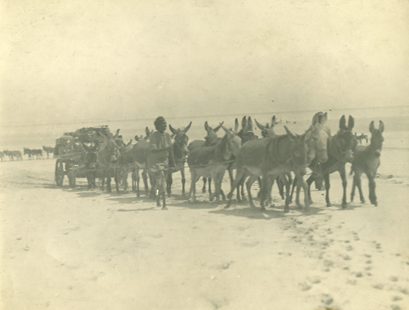
The Wallal Expedition
Notes:
In 1922 the Wallal expedition to test Einstein’s newly proposed Theory of Relativity.
Expeditions had been previously launched failed due to bad weather, the Great War and instrumental deficiency.

Slide 17
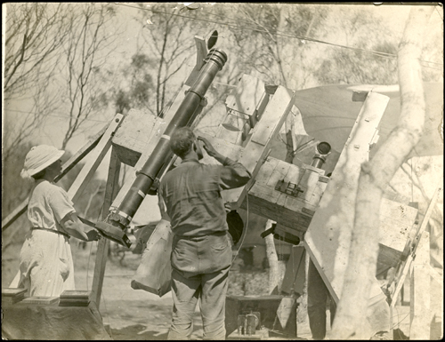
The Wallal Expedition
Notes:
Solar eclipse was on the 21 September 1922 and the most favourable site Eighty Mile Beach on the northern coast of Western Australia.
Party's from England, the US, Canada, India, Perth Observatory, and Alexander Ross, the New Zealand Government Astronomer, and J.B.O. Hosking of Melbourne Observatory

Slide 18
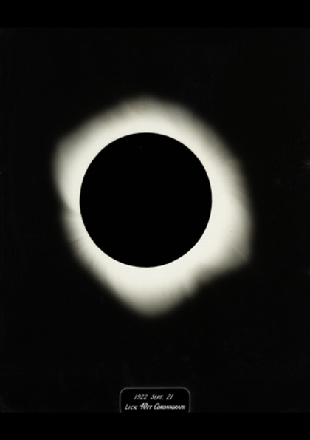
The Wallal Expedition
Notes:
The US team’s telescopes worked perfectly, and a few plates developed on the spot showed excellent images.
On April 1923, after meticulous research of the plates, the results were announced to Einstein and to the world with Einstein theories being vindicated

Slide 19
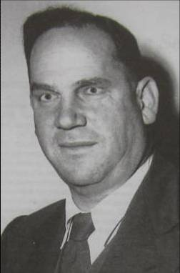
Hyman Spigyl Era
1940 to 1962
Notes:
Had a surveying background and progressed with rebuilding a post war ravaged Observatory
Staff had been reduced to two people during the great depression
Rejuvenated the time service, seismology services, completing the Astrographic Catalogues and restarted the publications for the Royal Astronomical Society

Slide 20
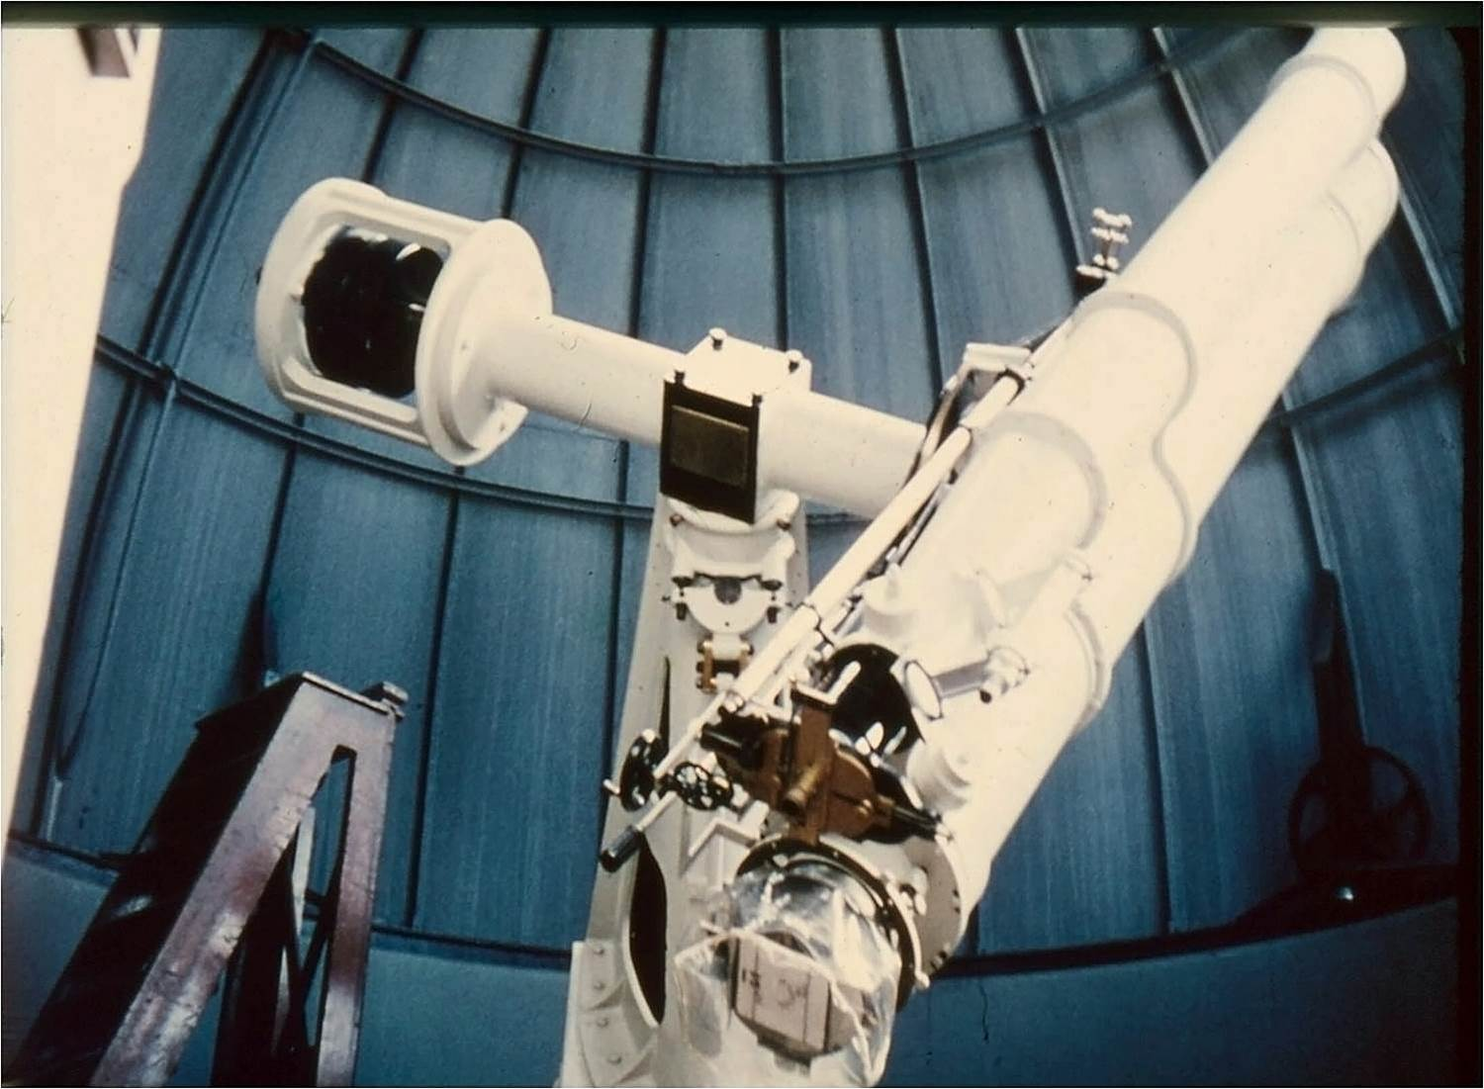
Edinburgh/Perth Astrographic Catalogues
Notes:
Between 1949 and 1953 the Edinburgh/Perth Astrographic Catalogues were published which record the position of 139 000 stars

Slide 21
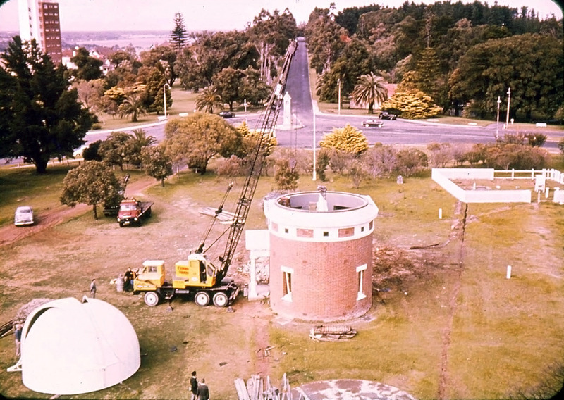
The Dome Roof Being Removed
Notes:
Actively searching for a new site for the Perth Observatory

Slide 22
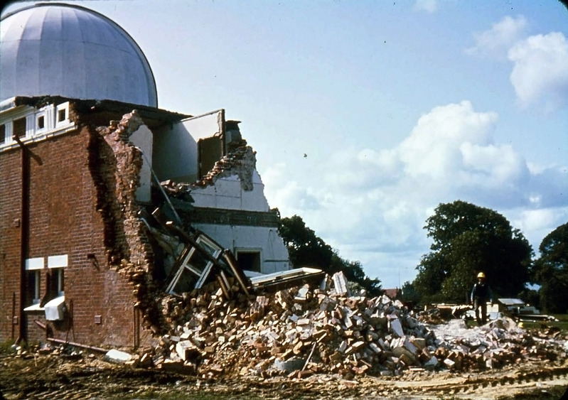
The Dome Being Demolished
Notes:
Result of the decision for it to be relocated due to the 1955 Stephenson-Hepburn Report
First plan for how Perth was going to grow
Professor Gordon Stephenson (1908 - 1997) – Town Planner
Alistair Hepburn (1915 – 2004) – Town Planning Commissioner

Slide 23
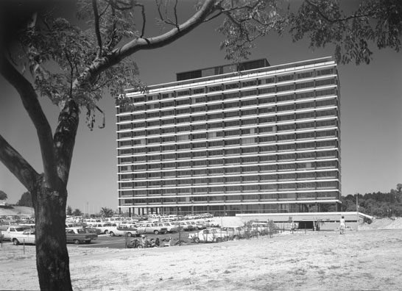
Dumas House
Notes:
A place where government offices could be located, close to Parliament House

Slide 24
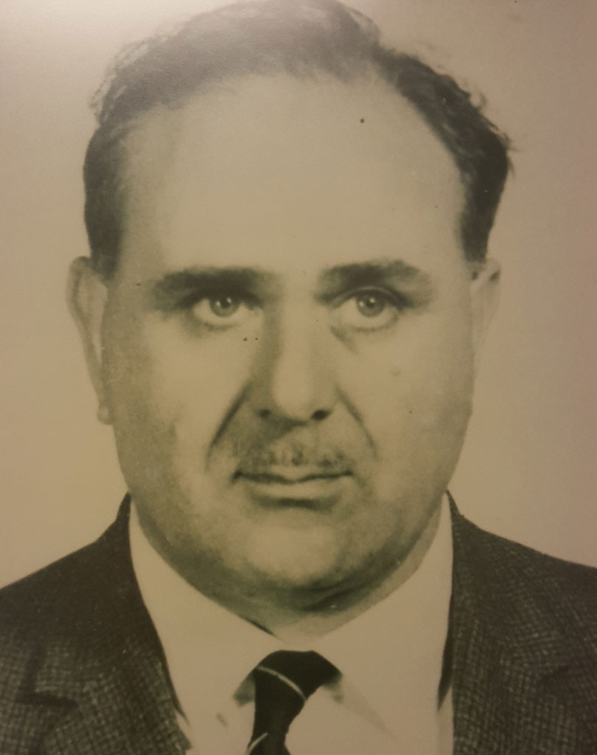
Bertrand Harris Era
1962 to 1974
Notes:
Harris, had been Spigl's assistant since 1957, became Government Astronomer after Spigl’s death
Step into the role at a time when the Observatory was moved to its new site in Bickley.

Slide 25
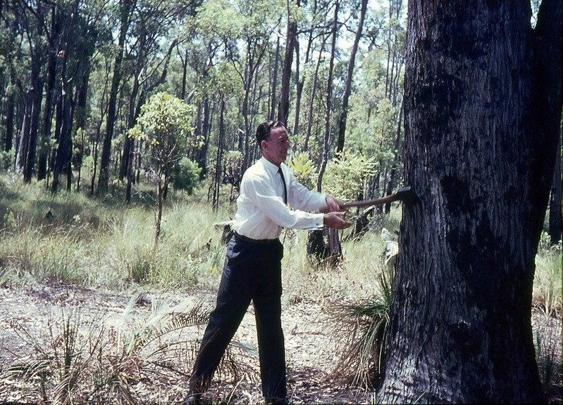
Minister For Works Cutting First Tree
Notes:
The clearing of the land and excavations commencing in 1964

Slide 26
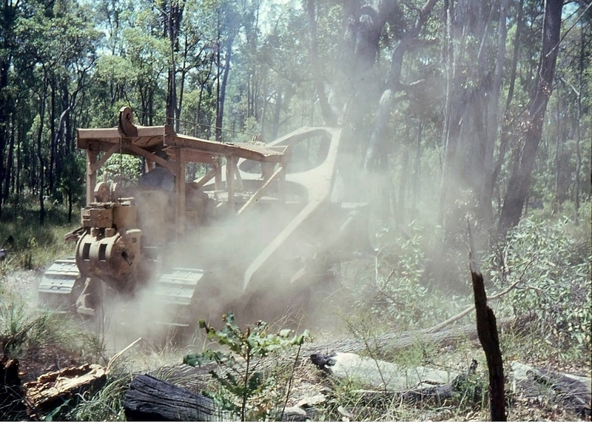
Then The Bulldozers Came In

Slide 27
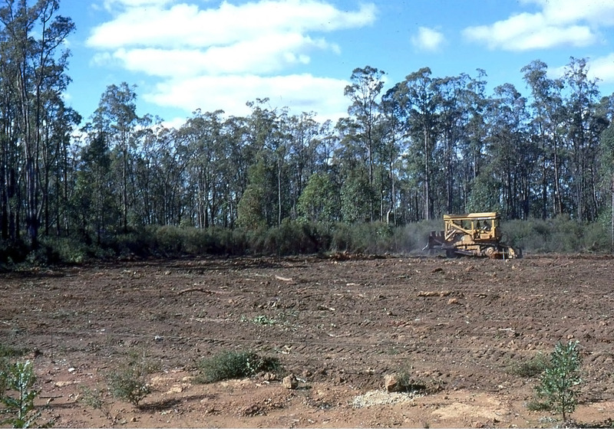
The Land Is Cleared By 1964

Slide 28
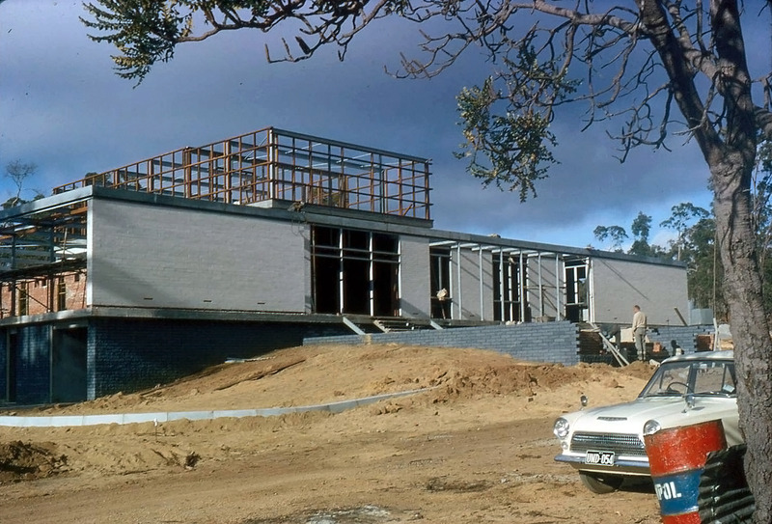
The Main Office Being Built
Notes:
Construction of buildings continued through 1965
Staff moved in at very end of 1965.
Built at a cost of $600,000, was opened by the Premier, David Brand, on 30/09/66

Slide 29
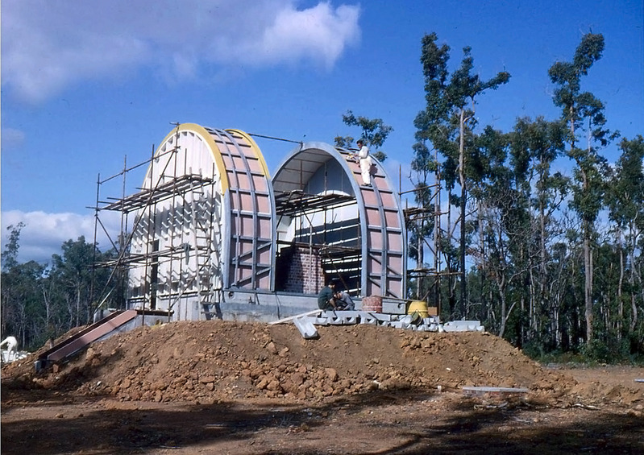
The Meridian Dome Being Built
Notes:
Harris oversaw the installation of a meridian circle telescope from the Hamburg Observatory in Germany in 1967.
The expedition revised, enlarged & more accurate meridian catalogue of the South Sky
The Perth 70 meridian catalogue mapped the position nearly 25,000 stars.

Slide 30
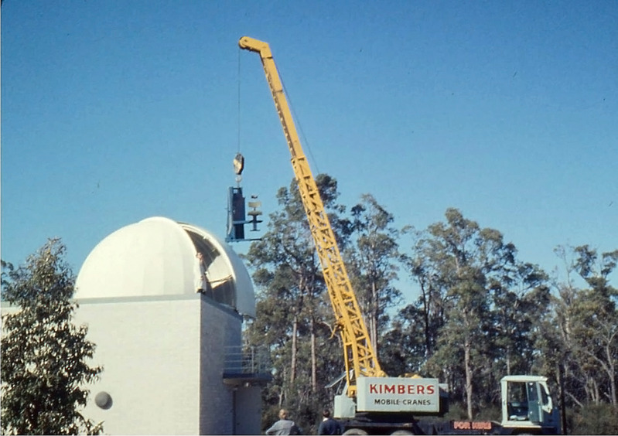
Astrographic Dome Being Rebuilt
Notes:
In 1967, Harris worked with the University of Western Australia to install a 16-inch telescope at the Observatory that was built and used by the UWA staff and students, as well as Perth Observatory staff.
Astrographic telescope recommenced observations in 1968 was in storage since 1963

Slide 31
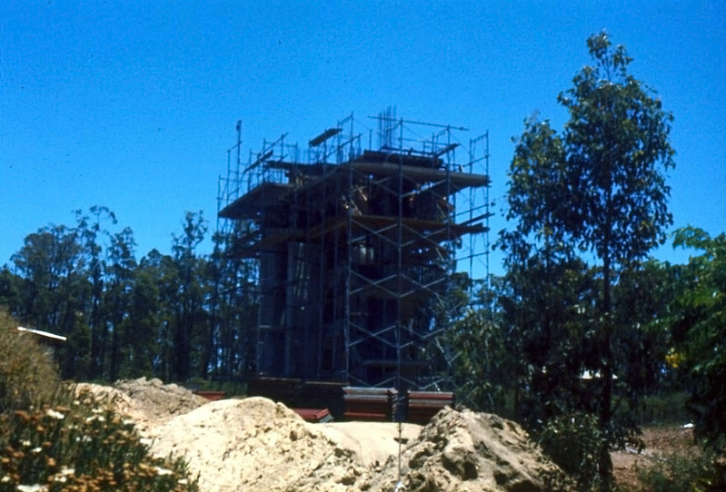
Lowell Dome Pillars Being Set
Notes:
In 1968, Perth Observatory joined NASA IPPP a project consisting of 7 telescopes
Designed to collect 35mm photographic data.

Slide 32
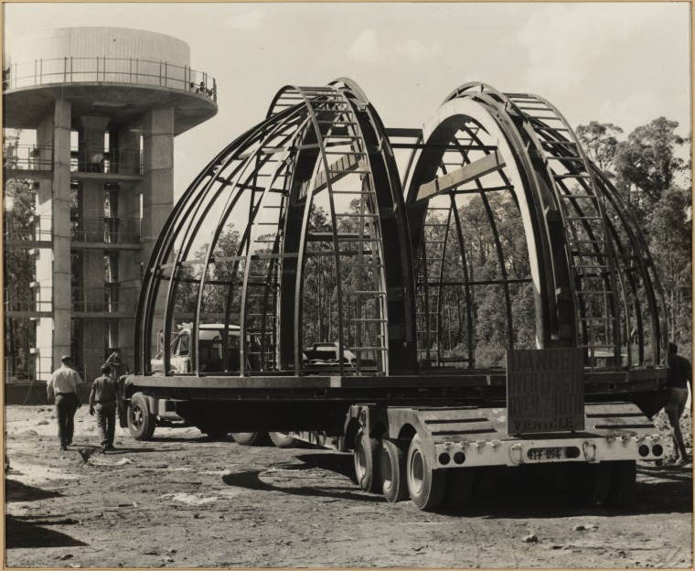
Truck Laden With The Dome
Notes:
In 1974, observations were scaled down to only the three most successful stations
In 1976, the program was suspended, and replaced by space probe technology.

Slide 33

Warning To OHS Workers

Slide 34
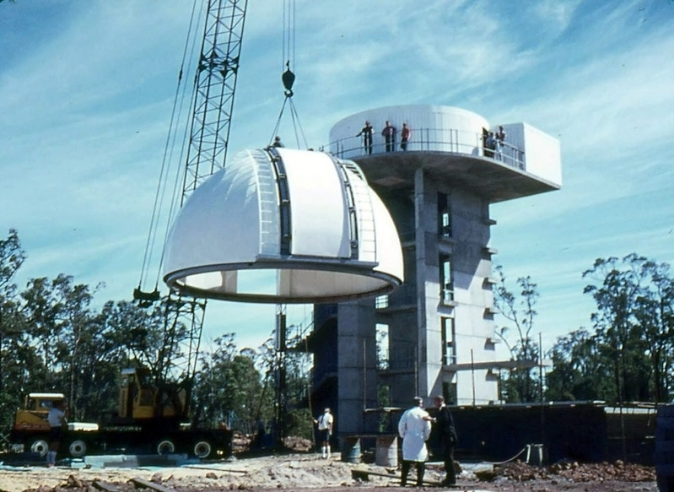
Lowell Dome Pillars Being Set

Slide 35
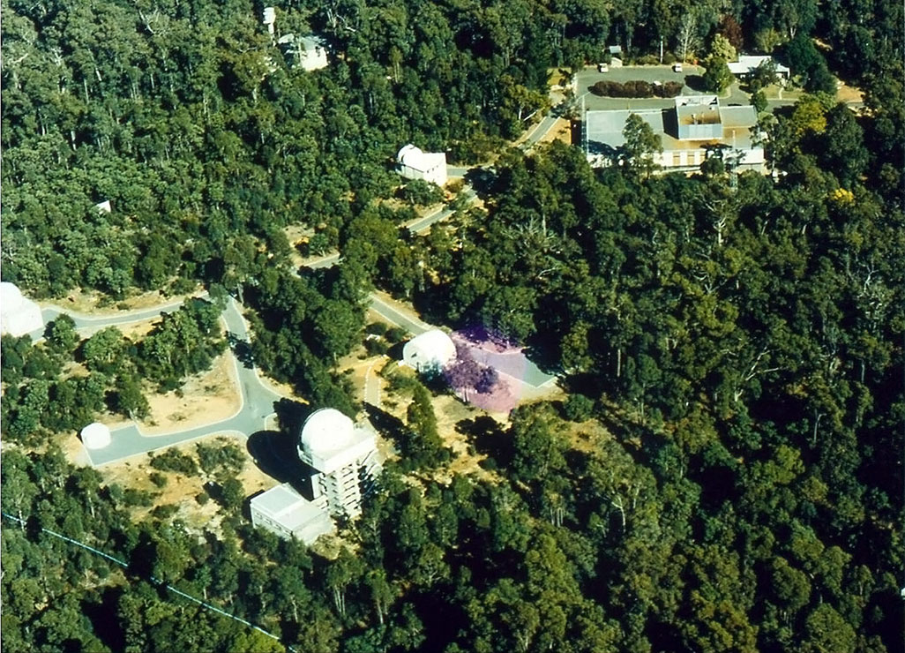
Aerial Shot Of The Observatory
Notes:
In 1966 He also restarted the public tours and also continued time and tide services
In 1970 Harris form dedicated Perth Observatory Meridian team resulting in the Perth 75 meridian catalogue which mapped nearing 2600 stars.
Responsible for 1973 IAU Symposium being held in Perth
Like his predecessor, he died at an early age, 49

Slide 36
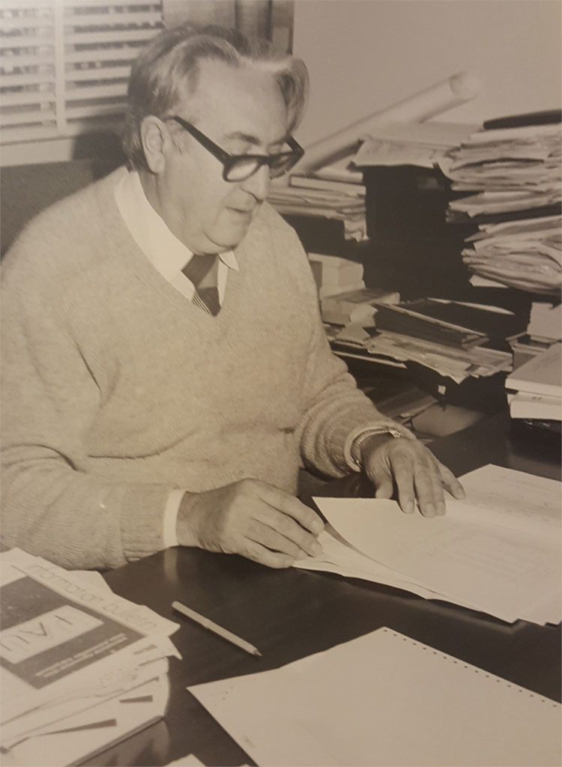
Iwan Nikoloff Era
1974 to 1984
Notes:
Acting Government Astronomer until it was made official in 1979
After arriving in Australia in 1964 from Bulgaria,
Nikoloff also worked with the German Hamburg Observatory meridian circle telescope expedition on the Perth 70 catalogue.

Slide 37
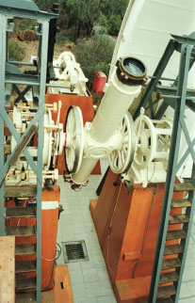
Hamburg Observatory Meridian Circle Telescope Expedition
Notes:
Would go to helped with the Perth 83 meridian catalogue which mapped the positions of over 12,000 stars.

Slide 38
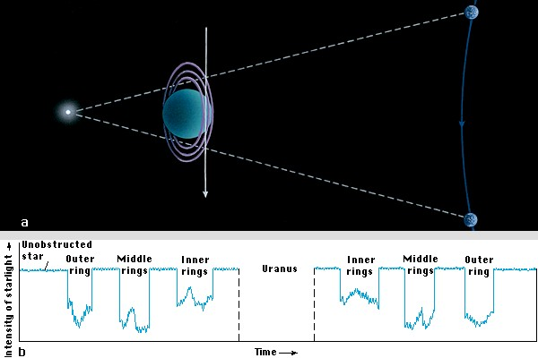
Co-Discovering Uranus’s Ring
Notes:
In 1977, Perth Observatory hosted Dr Mills from Lowell Observatory in Arizona, who had come to Perth to study the occultation of the star SAO158687 by Uranus.
Monitored the intensity of the starlight through a special filter

Slide 39
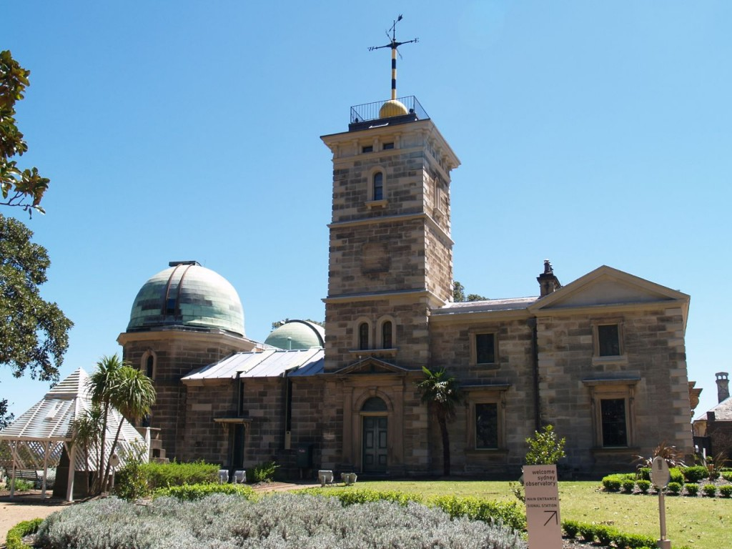
Sydney Observatory
Notes:
In 1980, the Celestron 14” Telescope Dome
In 1982, with the closure of the Sydney Observatory for research, Perth Observatory was the last State funded Observatory in Australia.
Iwan retired in 1985 and died in 2015 at the age of 93

Slide 40
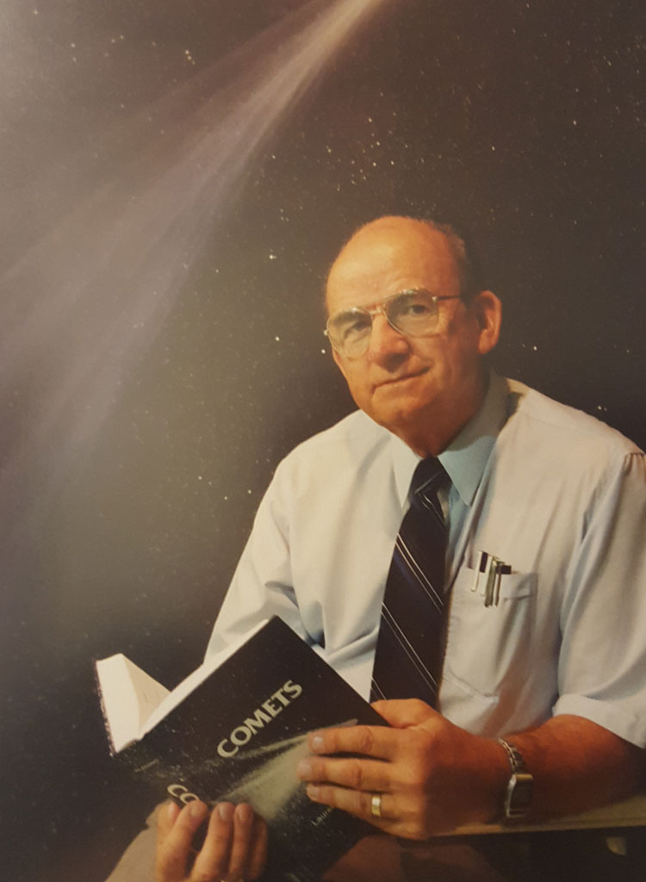
Mike Candy Era
1985 to 1993
Notes:
Oversaw Perth Observatory played a vital role in research of the Comet Halley in 1986.
The comet approached the Earth from the north, went behind the Sun, and then reappeared in the southern skies, and not accessible to northern hemisphere.

Slide 41
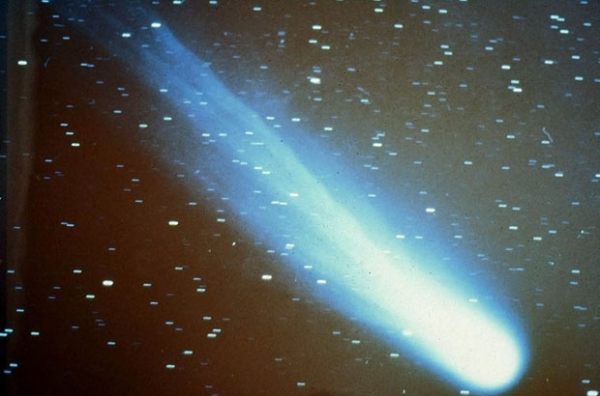
Comet Halley
Notes:
Positions of the comet taken with the Astrographic telescope were used to fine tune the positions of the comet for armada of spacecraft heading for the comet.
10% of all Earth-based positions of Comet Halley were taken from Perth

Slide 42
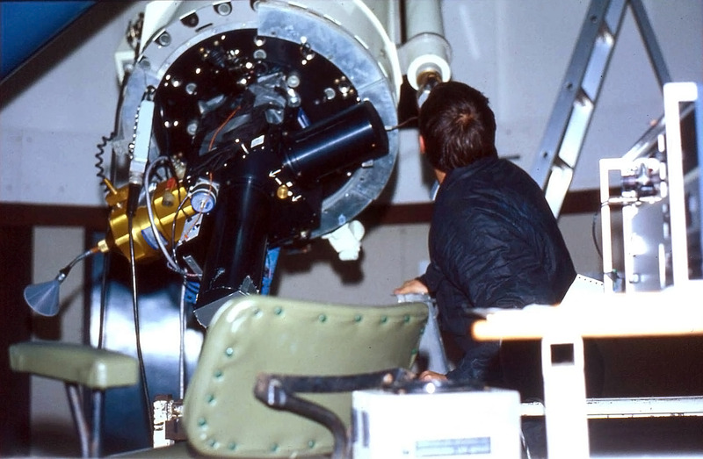
First Digital Camera Used In WA
Notes:
University of Maryland astronomers used Perth telescopes and the first digital camera in WA to study the physics of the comet,
The rotation period of the comet and CN Jets were confirmed from images taken from the Observatory

Slide 43
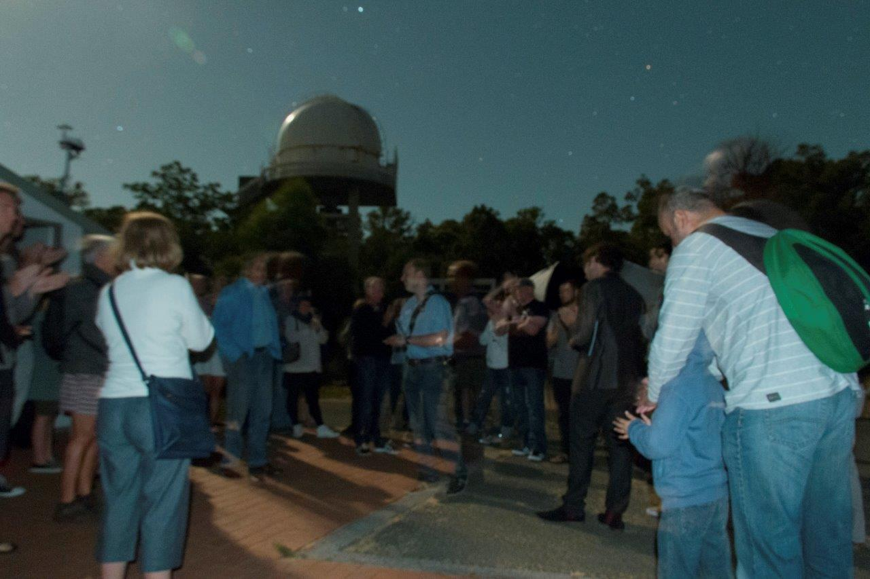
Night Tours Are Restarted
Notes:
In 1987, Minister for Works and Services, Peter Dowding, asked the Observatory to 'justify' their research projects and their annual budget of $750,000.
Half the staff were made redundant
In 1988 the staff decided to provide night tours again

Slide 44
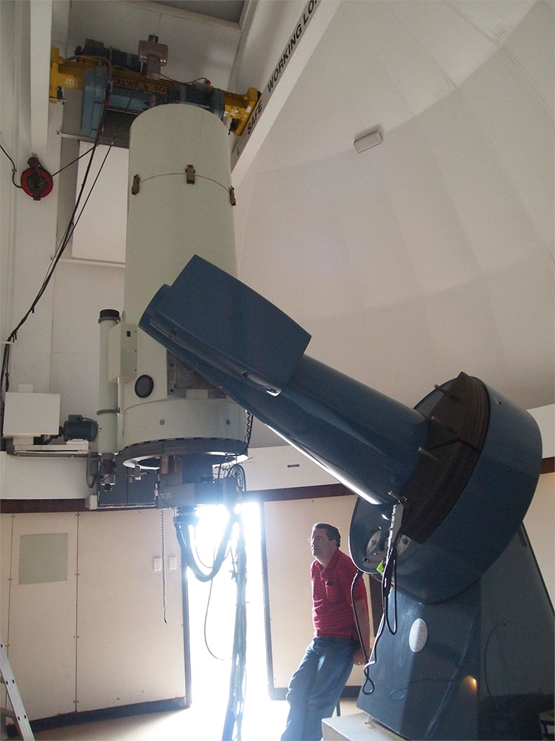
The Lowell Telescope
Notes:
In the early 1990s, the Lowell telescope was equipped with a special camera and automated with help from academics from UWA, Curtin, and Murdoch Universities
By 1996, six Supernovae had been discovered.
It was also during this period the museum was established

Slide 45
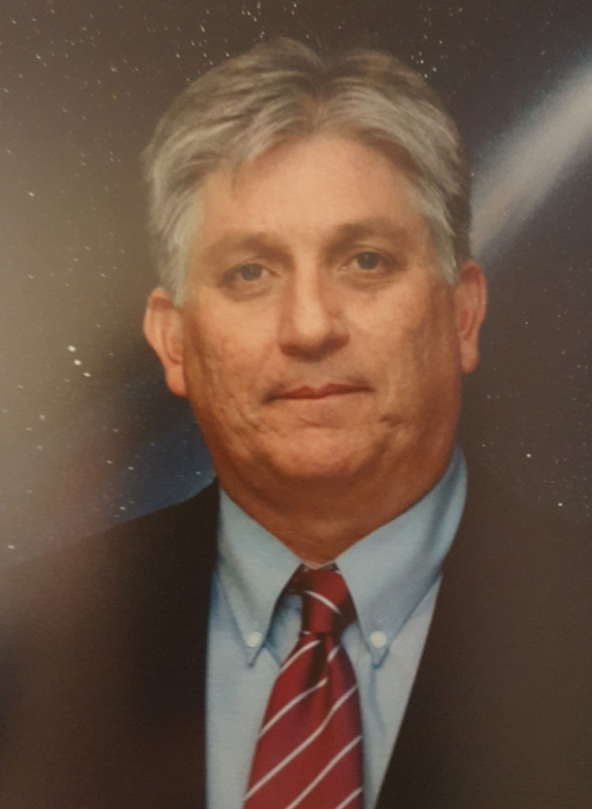
James Biggs Era
1994 to 2010
Notes:
The end of 1993 would see his retirement of Mike.
He wanted to bring the Observatory into the digital age: CCD imaging, and robotic telescopes.
Being part of the DEC we had the advantage allowing for the networking of computers to remote control of telescopes.

Slide 46
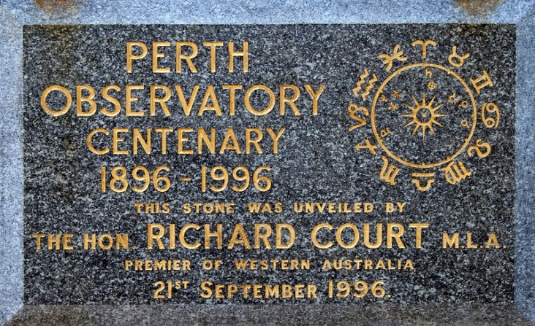
Centenary Foundation Stone
Notes:
The Observatory also celebrated its centenary. The event was held on the 21/09/96
Premier Richard Court who laid a new commemorative foundation
A series of ‘carpark astronomy nights’ were also held around the Perth City

Slide 47
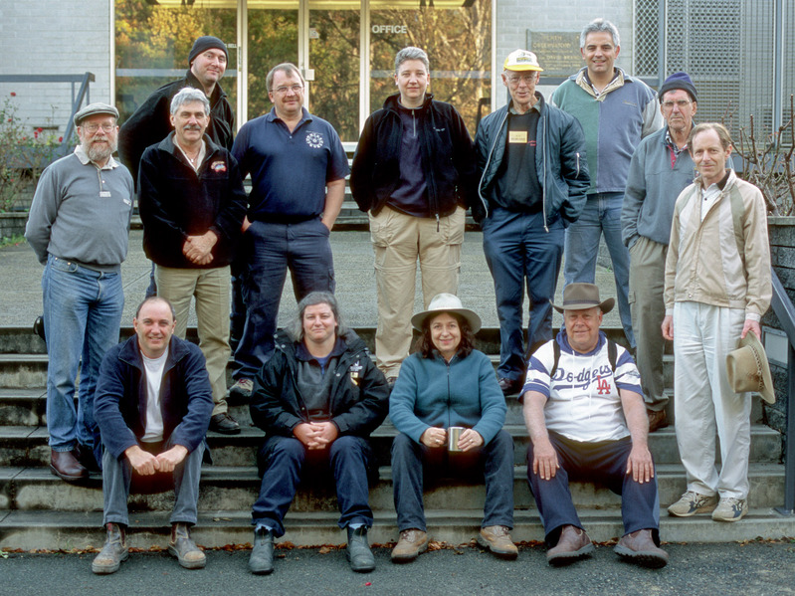
The POVG Founding Members
Notes:
In 1996 the Perth Observatory Volunteer Group was created to help the Astronomers with the NST’s
In 2001 the POVG became incorporated

Slide 48
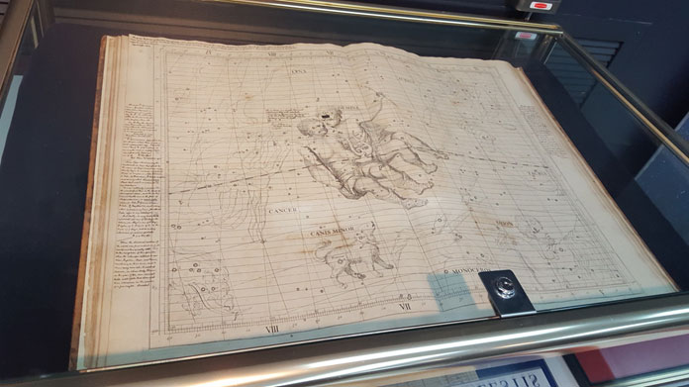
Atlas Coelestis
Notes:
In 2001 the ‘Atlas Coelestis’ was donated by Ethelwin Flamsteed Moffatt
Only ten are believed to exist in the World.
In 2005, the Perth Observatory was also entered on the Register of WA Heritage Places

Slide 49
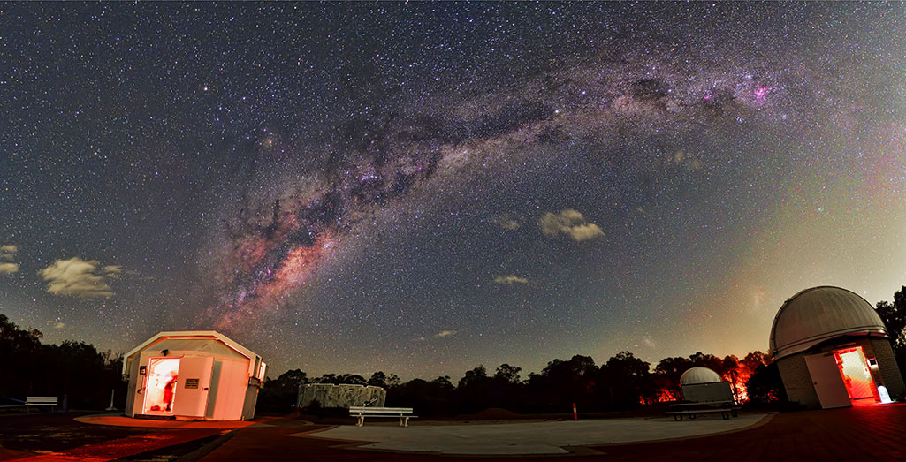
End Of Era But Also A Rebirth
2010 to Present
Notes:
The winds of change blow hard

Slide 50
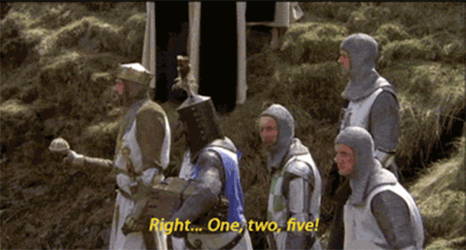
The Bomb Shell
Notes:
Research was to be finish in 2010
It was death by a 1000 cuts
Not helped with the financial mismanagement of the dome for the Lowell Telescope’s bigger brother which caused good employees to lose their jobs in the crossfire

Slide 51
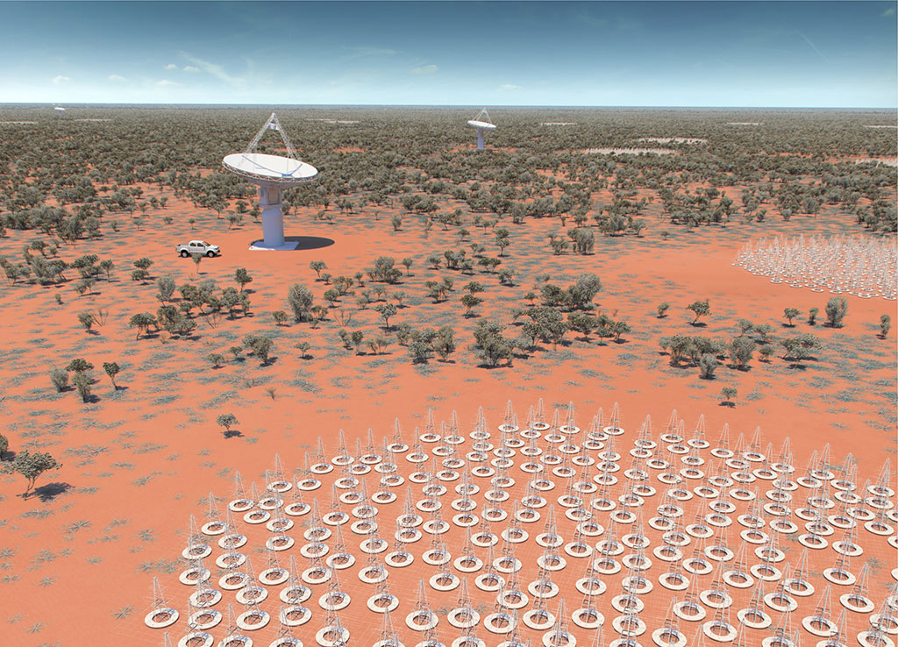
Square Kilometre Array
Notes:
Government focused on the SKA and ICRAR, the Gravity Wave Centre at Gingin.

Slide 52
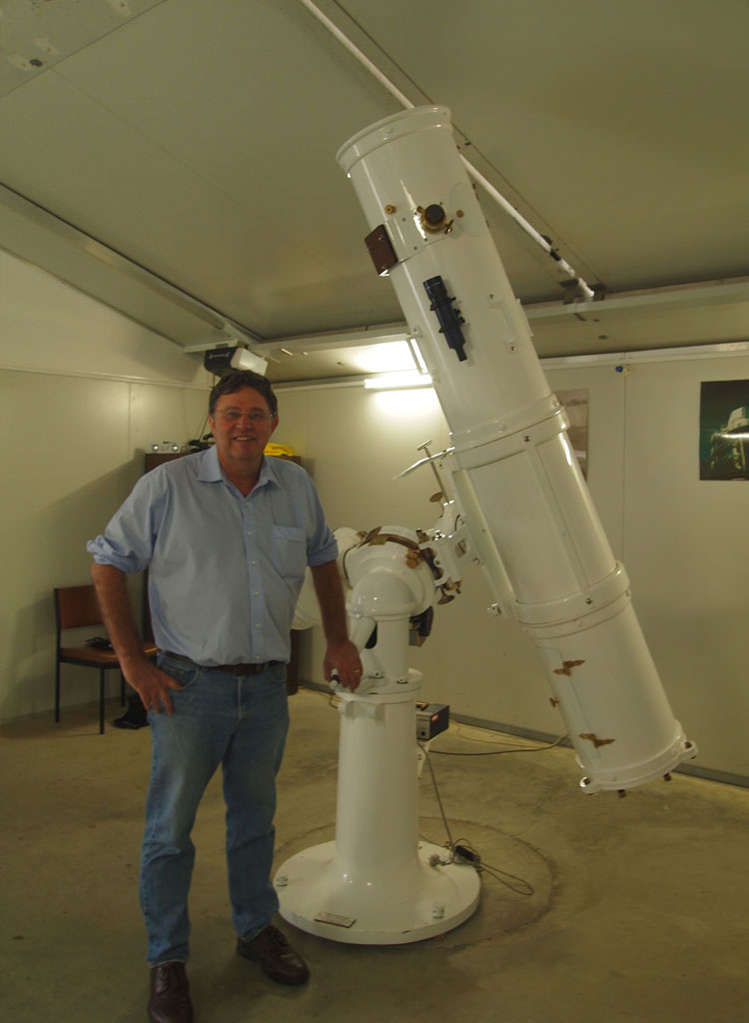
Ralph Martin
Notes:
Dr J Biggs is forced to resigned in 2010 and Mr Ralph Martin acted in the Directors position until 2013
From 2009, the POVG took control of performing public tours
Three months into joining the Observatory just before our Christmas BBQ we found out that redundancies had been offered
Greg Lowe the last manager under government rule finished on the 28th of February the 2015

Slide 53

Signing Of The 10 Year Commercial Agreement
Notes:
In June 2015 POVG entered into a 1 year community partnership agreement with DPAW which is now a 10 year agreement

Slide 54

Offsite Events
Notes:
We’ve gone to: Albany, Borden, Carnarvon, Geraldton, Hyden, Kalgoorlie, Karratha, Newman, Southern Cross and Trayning
We done viewings at the Perth Cultural Centre, the Old Perth Observatory with ODAT, parks with councils and schools

Slide 55



Special Events
Notes:
2016 we celebrated the 120th birthday, the 50th anniversary of the Bickley, and POVG 20th
Got 2500 people to the Open Day
ABC Stargazing Live World Record Attempt
May the 4th
Movie Night and Sundowners

Slide 56


Special Guests
Notes:
Neill DeGrasse Tyson, Perth Wildcats Captain Damien Martin and former NASA Apollo Flight Director Gerry Griffin

Slide 57




Politicians
Notes:
The Governor, Minister Dave Kelly, MLA for Kalamunda Matthew Hughes, Shadow Ministers Donna Faragher and Libby Mettam, Ken Wyatt and Alan Tudge

Slide 58

Streaming The Blue Blood Moon
Notes:
Got the call a week out do to an observatory in NSW and Japan couldn’t do it
Had the equipment and know how, but we had crappy internet
Crashed our website with 2500 visitors to our site within a couple of hours

Slide 59

Streaming The Blue Blood Moon
Notes:
1.1 million views with over 18,000 views at anyone time with 5,000 person waiting list
We has 150 people at the Observatory

Slide 60



Streaming The Moon & Eclipses
Notes:
3.4 million views for the July 2018 Total Lunar Eclipse
Over 600,000 views for the July 2019 Partial Lunar Eclipse
Over 834,000 views for the May 2021 Total Lunar Eclipse
We’ve done live streaming through the telescopes since COVID started

Slide 61




Celebrated Our 125th Birthday
Notes:
On Wednesday the 29th of September 2021 we celebrated our 125th birthday
And held CosmosCon on Saturday the 2nd of October 2021 to celebrate
We got 600 people

Slide 62



The Future Is Bright
Notes:
Since lockdown finished in 2020 our night tours have been booked up months in advanced
We won the 2017 Volunteering WA Organisation Of The Year on our first try
We have DGR status now that allows us to go for grants and donations

Slide 63

Research Is Coming Back
Notes:
Night Cameras have been installed on the roof of the main building to record meteors
COMSPOC telescope records the night sky for satellites and space junk
Recorded the Occultation of the asteroids Patroclus and Menoetius for NASA’s Lucy mission in Shark Bay

